Slide 1
8259 (PIC)

Slide 2
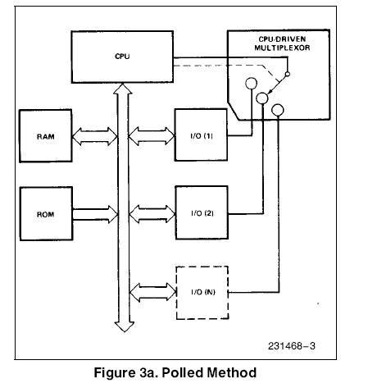

Slide 3
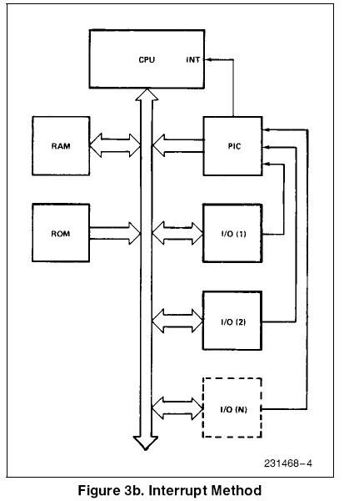

Slide 4
Programmable Interrupt Controller (PIC)
8259 is Programmable Interrupt Controller (PIC)
It is compatible with 8085, 8086 and 8088 microprocessors
It is a tool for managing the interrupt requests.
8259 is a very flexible peripheral controller chip:
  PIC can deal with up to 64 interrupt inputs
  interrupts can be masked
  various priority schemes can also programmed.
It uses NMOS technology and requires +5V power supply for operation
In some of the modern processors, the functionality of the PIC is built in.

Slide 5
Architecture of PIC-8257
FUNCTIONAL BLOCK DIAGRAM OF 8259:
It has eight functional blocks. They are:
Control logic
Read Write logic
Data bus buffer
Interrupt Request Register (IRR)
In-Service Register (ISR)
Interrupt Mask Register (IMR)
Priority Resolver (PR)
Cascade buffer.

Slide 6
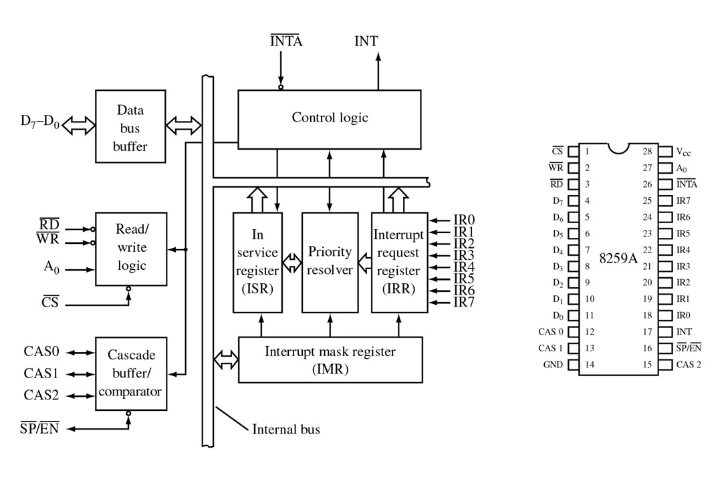
FIGURE 9-4 Block diagram and pin definitions for the 8259A Programmable Interrupt Controller (PIC). (Courtesy of Intel Corporation.)

Slide 7
Architecture of PIC-8259
Data Bus Buffer:
Data bus and its buffer are used for the following activities:
  It is bidirectional data buffer interfaces internal 8259A to the microprocessor system data bus
Read/Write control logic
The function of this block is to accept Output commands from the CPU. It contains the Initialization Command Word (ICW) registers and Operation
Command Word (OCW) registers which store the various control formats for device operation. This function block also allows the status of the 8259A to be transferred onto the Data Bus.

Slide 8
Architecture of PIC-8259
Interrupt request register:
The IRR has eight input lines (IR0-IR7) for interrupts. When these lines go high, the request is stored in IRR in order to serve them one by one on the priority basis. It registers a request only if the interrupt is unmasked.
Normally IR0 has highest priority and IR7 has the lowest priority. The priorities of the interrupt request input are also programmable.
Interrupt mask register (IMR):
The interrupt mask register (IMR) stores the masking bits of the interrupt lines to be masked. The relevant information is send by the processor through OCW.
In-service register(ISR):
The in-service register keeps track of which interrupt is currently being serviced.

Slide 9
Architecture of PIC-8259
Priority resolver:
The priority resolver examines the interrupt request, mask and in-service registers and determines whether INT signal should be sent to the processor or not.
The IR0 has the highest priority while the IR7 has the lowest priority, normally in fixed priority mode.
The priorities however may be altered by the programming the 8259A in rotating mode.

Slide 10
Cascade buffer/comparator:
The cascade buffer/comparator is used to expand the interrupts of 8259.
In cascade connection one 8259 will be directly interrupting 8086 and it is called master 8259.
To each interrupt request input of master 8259 (IR0-IR7), one slave 8259 can be connected. The 8259s interrupting the master 8259 are called slave 8259s.
Each 8259 has its own addresses so that each 8259 can be programmed independently by sending command words and independently the status bytes can be read from it.

Slide 11
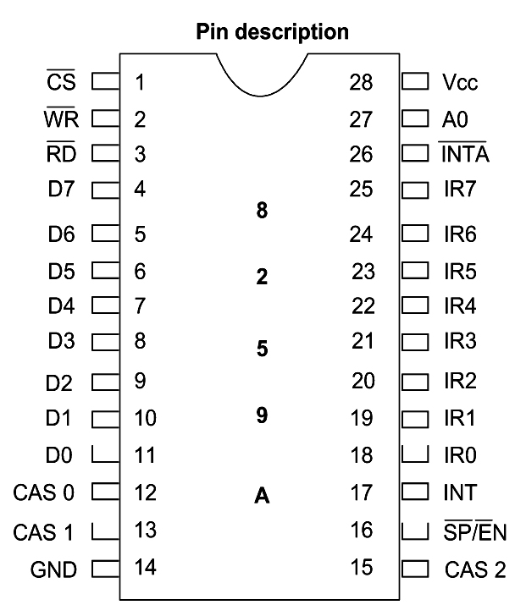
Figure 14-3 8259A Programmable Interrupt Controller

Slide 12
Pin description
CS (CHIP SELECT) :
A LOW on this input enables the 8259A. No reading or writing of the chip will occur unless the device is selected.
WR (WRITE):
A LOW on this input enables the CPU to write control words (ICWs and OCWs) to the 8259A.
RD (READ) :
A LOW on this input enables the 8259A to send the status of the Interrupt Request Register (IRR), In Service Register (ISR), the Interrupt Mask Register (IMR), or the Interrupt level onto the Data Bus.
A0:
This input signal is used in conjunction with WR and RD signals to write commands into the various command registers, as well as reading the various status registers of the chip. This line can be tied directly to one of the address lines.

Slide 13
Pin description
D7 - D0: BIDIRECTIONAL DATA BUS- Control, status and interrupt-vector
information is transferred via this bus.
CAS0 - CAS2: CASCADE LINES: The CAS lines form a private 8259A bus to
control a multiple 8259A structure. These pins are outputs for a master
8259A and inputs for a slave 8259A.
SP/EN: SLAVE PROGRAM/ENABLE BUFFER: This is a dual function pin.
When in the Buffered Mode it can be used as an output to control buffer
transceivers (EN). When not in the buffered mode it is used as an input to
designate a master (SP e 1) or slave (SP e 0).
INT : INTERRUPT: This pin goes high whenever a valid interrupt request is
asserted. It is used to interrupt the CPU, thus it is connected to the CPU's
interrupt pin.
INTA: INTERRUPT ACKNOWLEDGE: This pin is used to enable 8259A
interrupt-vector data onto the data bus by a sequence of interrupt acknowledge
pulses issued by the CPU.

Slide 14
INTERRUPT SEQUENCE
The events occur as follows in an 8086 system:
1. One or more of the INTERRUPT REQUEST lines (IR7 – IR0) are raised high, setting the corresponding IRR bit(s).
2. The 8259A evaluates these requests, and sends an INT to the CPU, if appropriate.
3. The CPU acknowledges the INT and responds with an INTA pulse.
4. Upon receiving an INTA from the CPU group, the highest priority ISR bit is set, and the corresponding IRR bit is reset. The 8259A will also release a CALL instruction code (11001101) onto the 8-bit Data Bus through its D7 - D0 pins.
5. This CALL instruction will initiate second INTA pulses to be sent to the 8259A from the CPU group.
6. This INTA pulse allow the 8259A to release an 8-bit preprogrammed subroutine address onto the Data Bus.

Slide 15
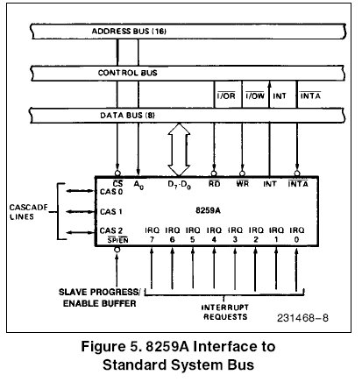

Slide 16
Command words of 8259A
PROGRAMMING THE 8259A
The 8259A accepts two types of command words generated by the CPU:
Initialization Command Words (ICWs): Before normal operation can begin, each 8259A in the system must be initialized by writing 2 to 4 command words in the resp. command word reg.
2. Operation Command Words (OCWs): These are the command words which command the 8259A to operate in various interrupt modes. These modes are:
a. Fully nested mode
b. Automatic Rotation mode
c. Specific Rotation mode

Slide 17
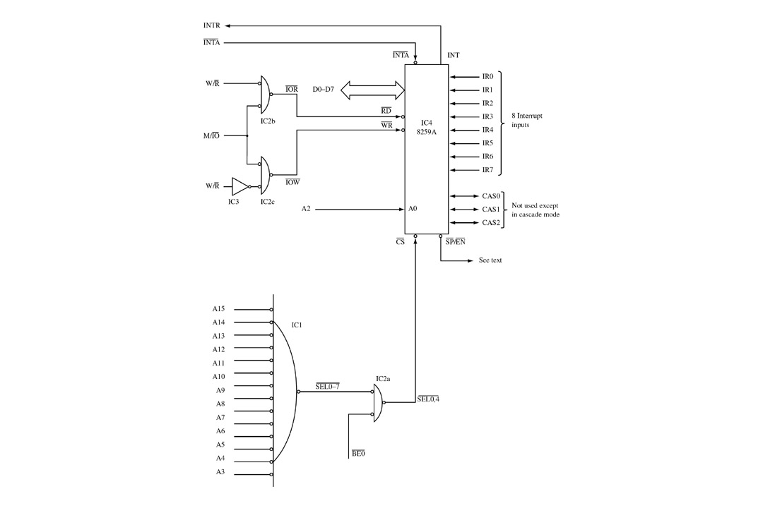

Slide 18
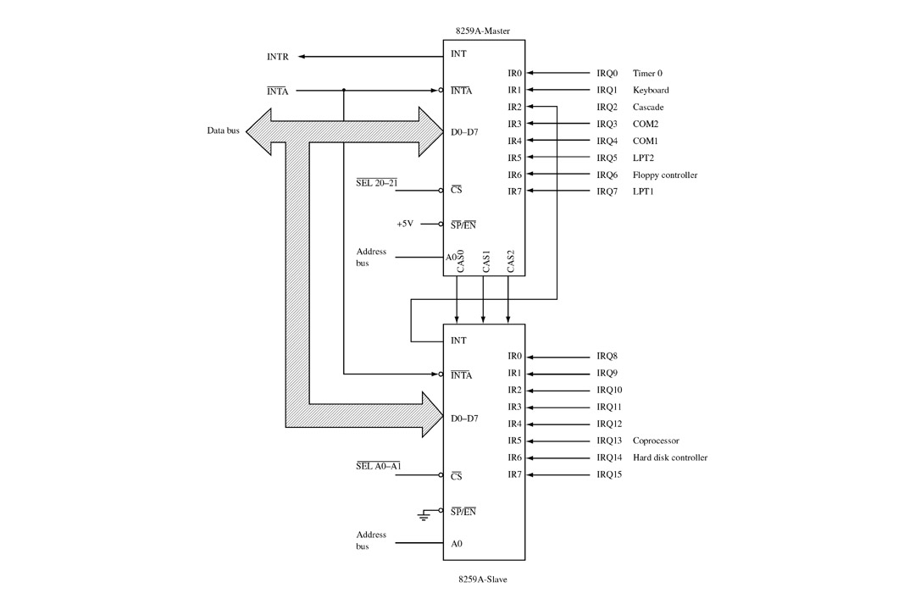

Slide 19
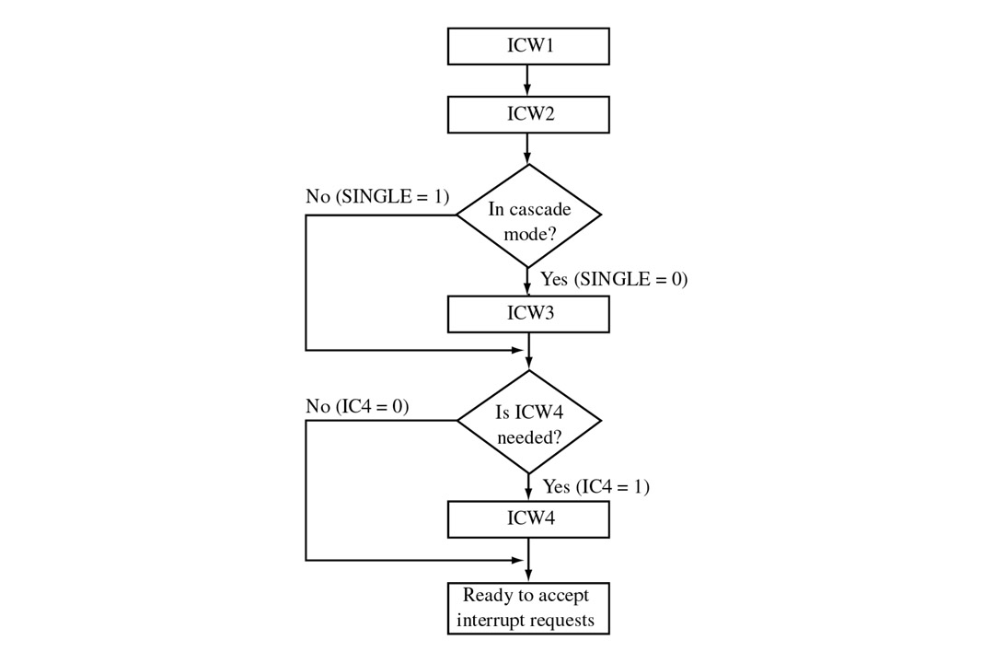
FIGURE 9-12 8259A initialization sequence. (Courtesy of Intel Corporation.)

Slide 20
DMA
Direct Memory Access.
In memory-memory or memory-peripherals communication, the processor is a “middleman” which is not really needed.
Used with HOLD HOLDA signals.
DMA requires another processor - The DMA Controller or DMAC- to generate the memory and I/O addresses.
8237 is a DMAC.
In IBM PC, 8237 was used to speed up the read or write operation by the slow 8088 processor.
Nowadays, It is usually used by sound cards and by memory controllers to generate row address for refreshing.

Slide 21
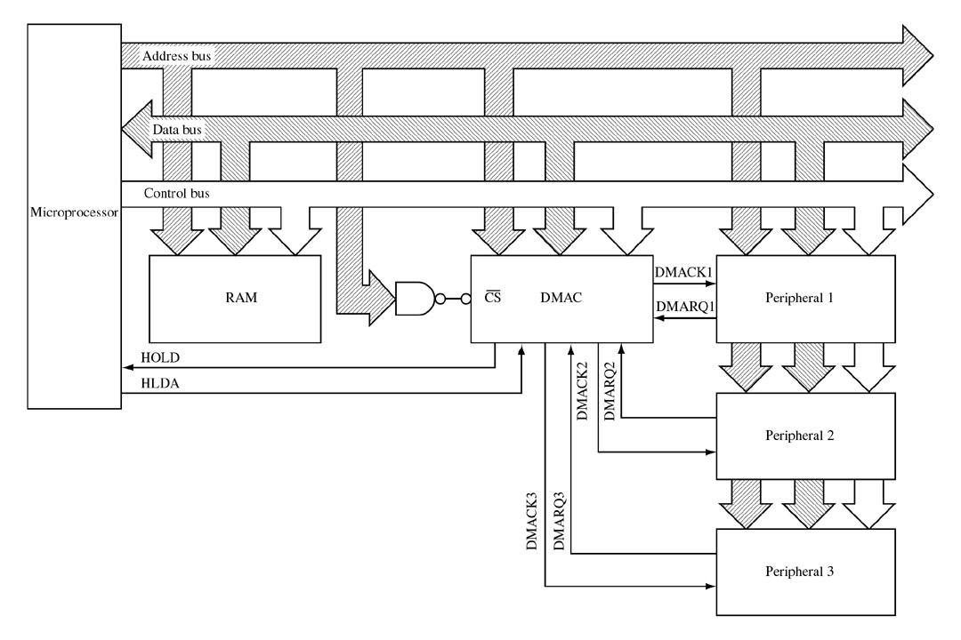
FIGURE 9-17 A DMA controller allows the peripheral to interface directly with memory without processor intervention. This allows the data transfer rate to approach the access time of memory.
Types:
Sequential DMA
Simultaneous DMA

Slide 22
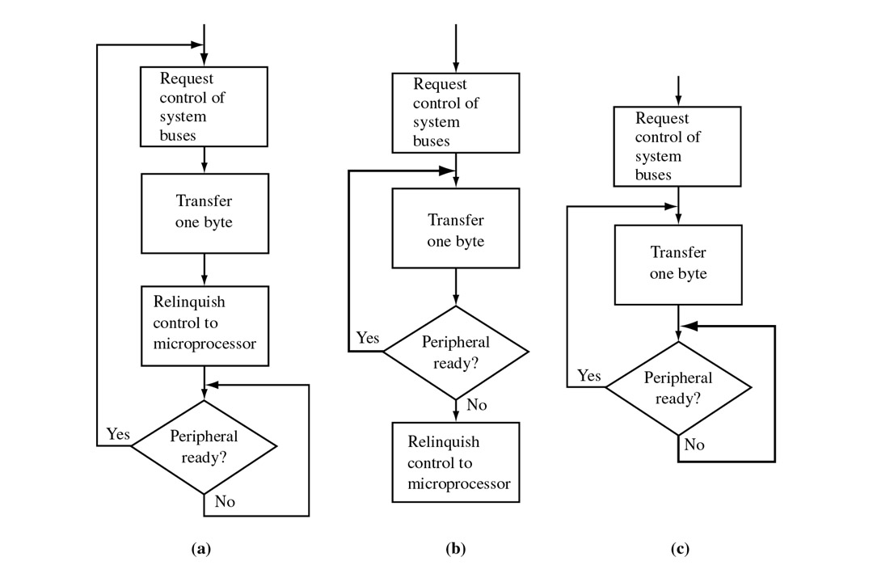
FIGURE 9-18 Three methods (MODES) of DMA operation: (a) byte; (b) burst; (c) block.

Slide 23
I/O summary
Three ways to synchronize the processor to data rate of peripherals:
1- Polling: which provides a fast response but it the processor recourses are dedicated to one peripheral.
2- Interrupt approach: is much more efficient. the processor only services the peripheral when data is required. requires high software overhead.
3-DMA is a third solution but it increases the complexity of the hardware system.

